Slide 1
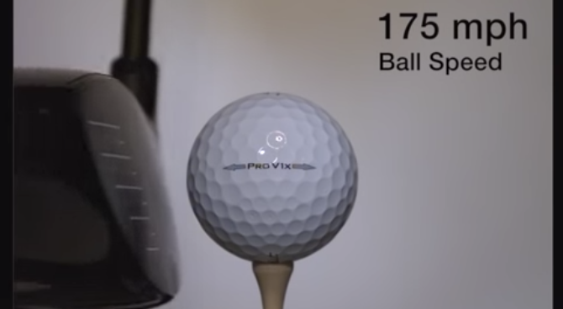
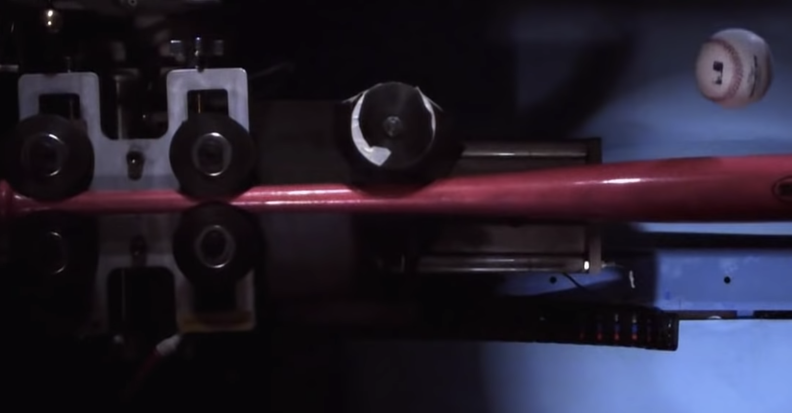

Slide A
Whole Group
We’ve been using forces to explain deformation of objects in a collision (or any time they make contact).
In golf, the club is moving before it collides with the ball and the ball is motionless.
But in baseball, the bat and the ball are typically both moving before a collision between them.
TITLEIST
was moving at first
was motionless
at first
Discuss as a Class
In each collision, what is doing the pushing and what is getting pushed?
Discovery Access
was moving at first
was moving at first
Notes:
5 min. Reintroduce the questions students were considering at the end of the last lesson. Say, We’ve been using forces to explain deformation of objects in a collision or any time they make contact. So let’s consider some of the cases we’ve looked at before using this force perspective. Show slide A. Give students a moment to reread the text on the slide. Then say, What did you and your partner predict about these two different cases? Were you in agreement or did you have different ideas?
Share ideas about forces between objects in a collision. Anticipate some disagreement in students' responses. Encourage students to weigh in on the ideas that are shared so you can help students recognize that we are either not in agreement or we are uncertain about some of our predictions and need additional evidence to support alternate ideas.
Say, It seems like figuring out what is pushing on what is something we need to resolve in order to explain why some things break and others don’t in a collision. Let’s look more closely at the interactions between two objects to see if we can figure out what is getting pushed in a collision. Maybe if we start by thinking about where the force is occuring during a collision, that will help us make progress on figuring out what is getting pushed and what is doing the pushing.

Slide 2
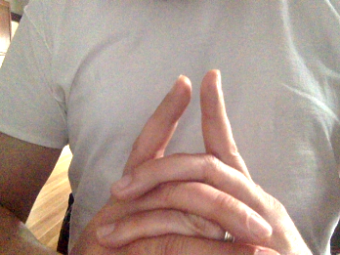
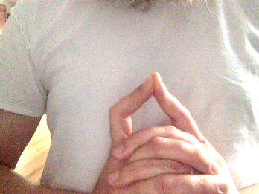
Exploring Force Interactions with Fingers
Slide B
Begin by holding your index fingers about a centimeter apart.
Do you feel any push between your fingers when they are not touching?
Slowly push your right fingertip into your left fingertip.
Do you feel a push on your left fingertip?
Do you feel a push on your right fingertip?
Repeat all of the steps, but switch fingers. Slowly push your left fingertip into your right fingertip.
Repeat all of the previous steps with your eyes closed.
Notes:
8 min. Begin the exploration of force interactions between two objects. Say, Let’s start our investigations with our own built-in force sensors: our fingers.
Show slide B and instruct students to follow the directions on the slide either on their own or in tandem with a partner if they want to do so. Don’t take time to have students report out their results to the whole group yet though.
After everyone has completed these steps, which should take under 2 minutes, say, We can use our fingers as a force sensor in a different way too. Prompt students for an additional line of evidence we can use to determine that forces are being applied to any object.
Suggest that we repeat the investigation again but that this time we look for deformation of our fingertips to determine which fingertip is getting pushed on when they make contact with each other.

Slide 3
Exploring Force Interactions with Fingers
Slide C
Do all of these steps with your eyes open, paying close attention to which fingertip’s surface deforms.
Slowly push your right fingertip into your left fingertip. Look for deformation of each fingertip.
Do you see the surface of your left fingertip deform?
Do you see the surface of your right fingertip deform?
Repeat the last steps, but switch fingers. Slowly push your left fingertip into your right fingertip.
Now repeat all the steps, pushing one fingertip against another a little harder.
How does that affect the amount of deformation you see on each fingertip?
Notes:
Show slide C and instruct students to follow the directions on the slide either on their own or in tandem with a partner if they want to do so. After everyone has completed these steps, which should take under 2 minutes, bring students together to discuss the results. Encourage students to look at what their fingers are doing again as they talk through these questions.
Suggested prompts and potential responses can be found in the teacher guide.

Slide 4
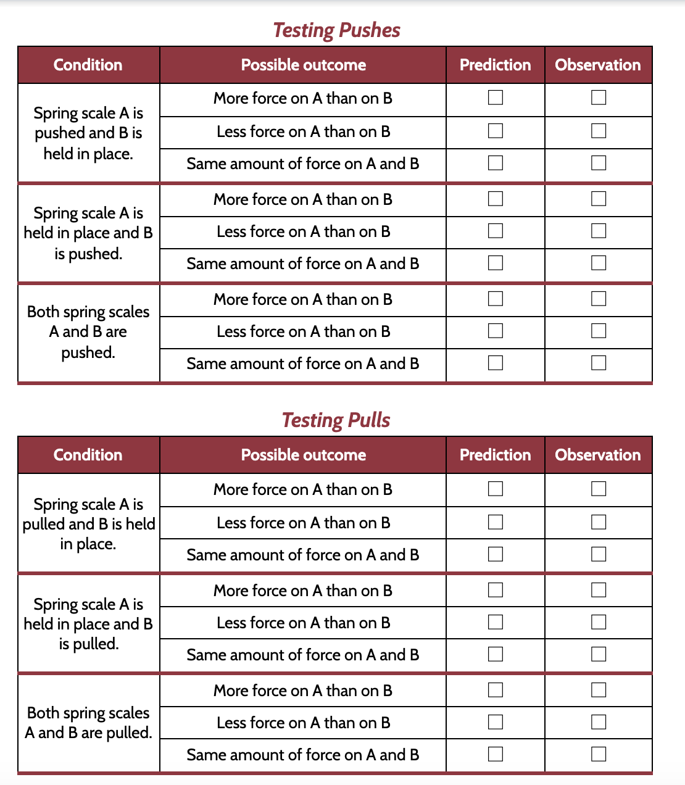
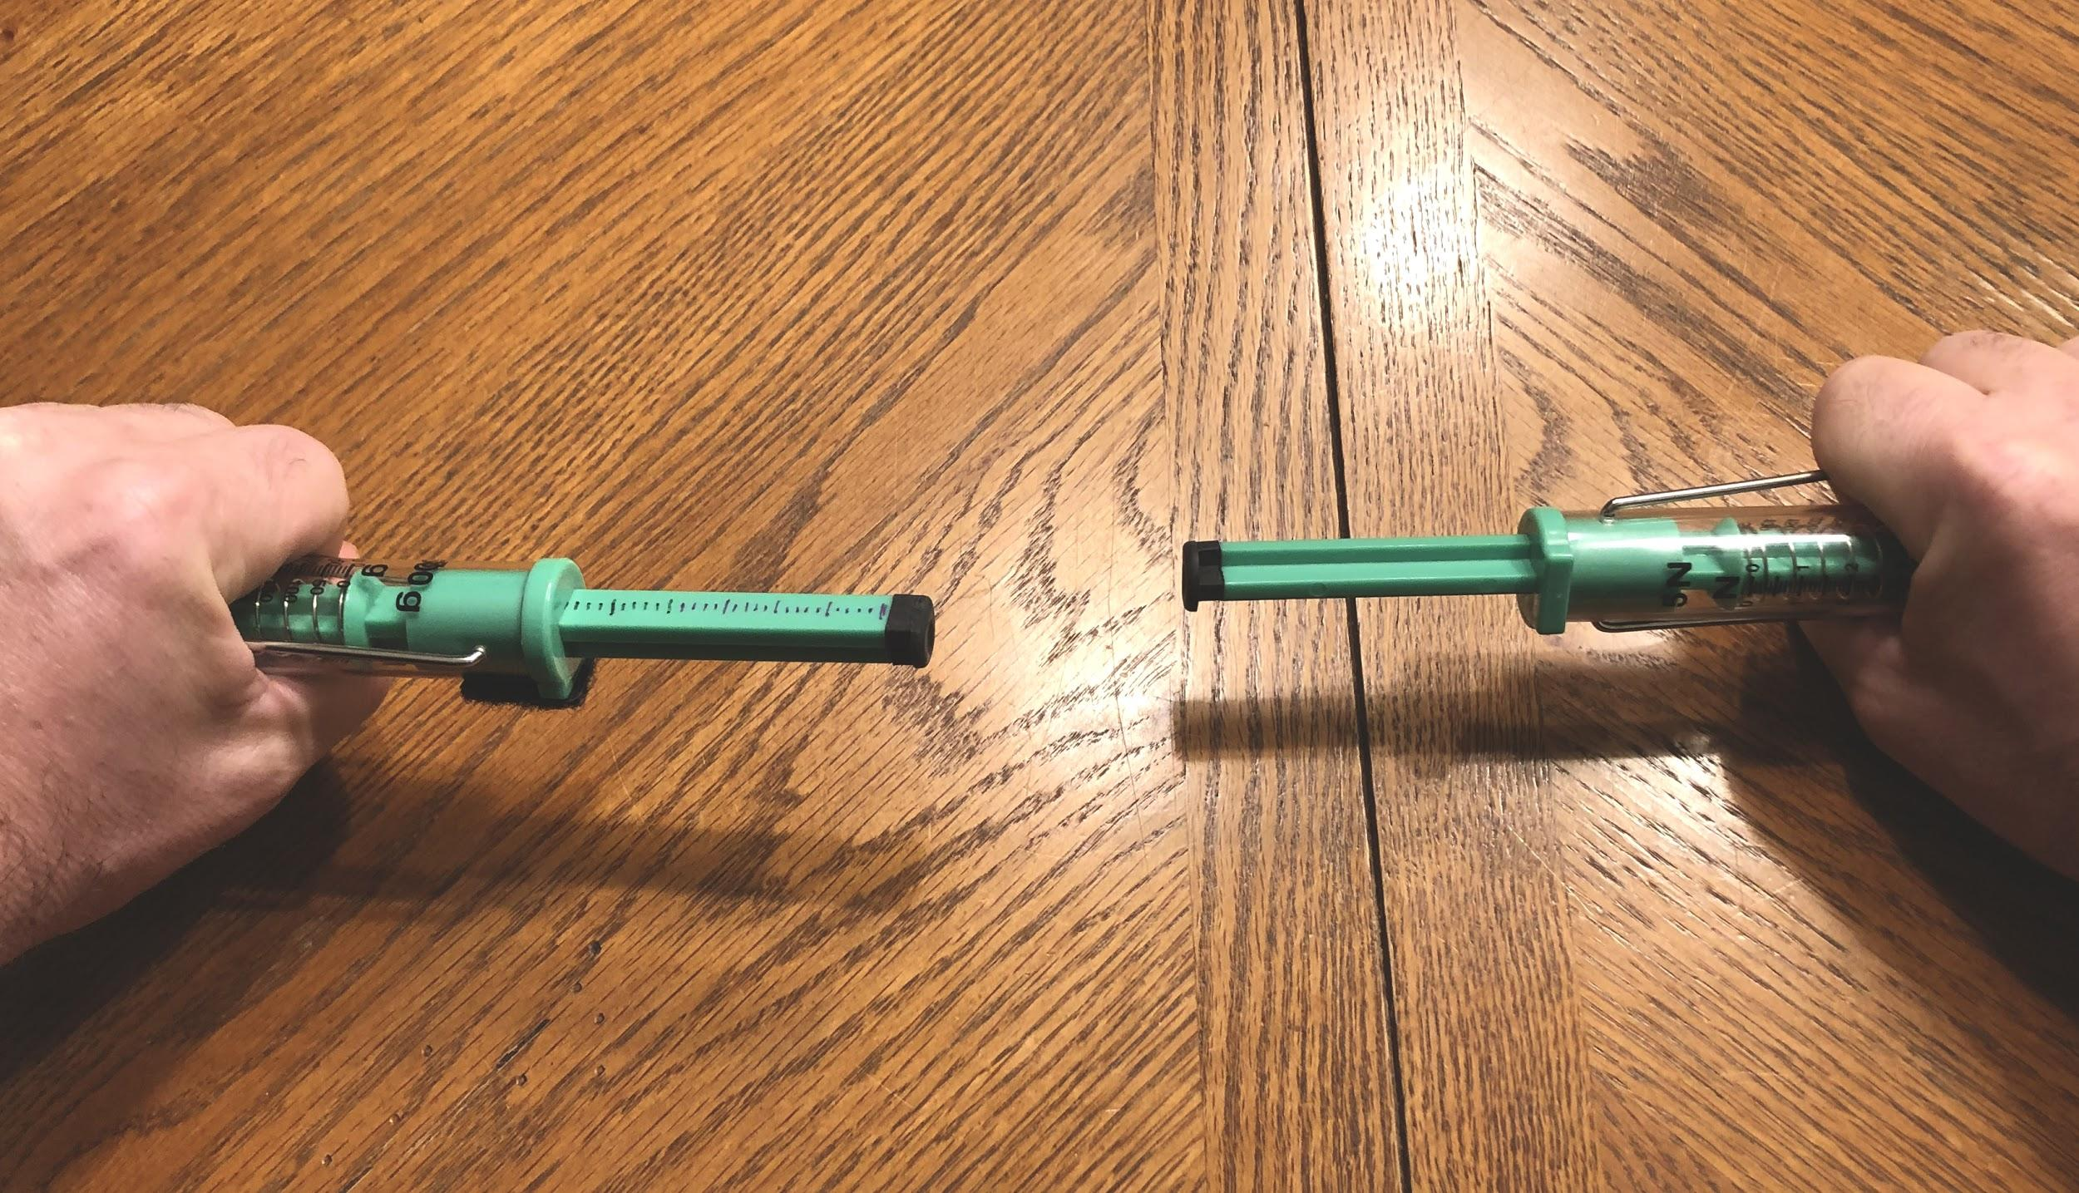
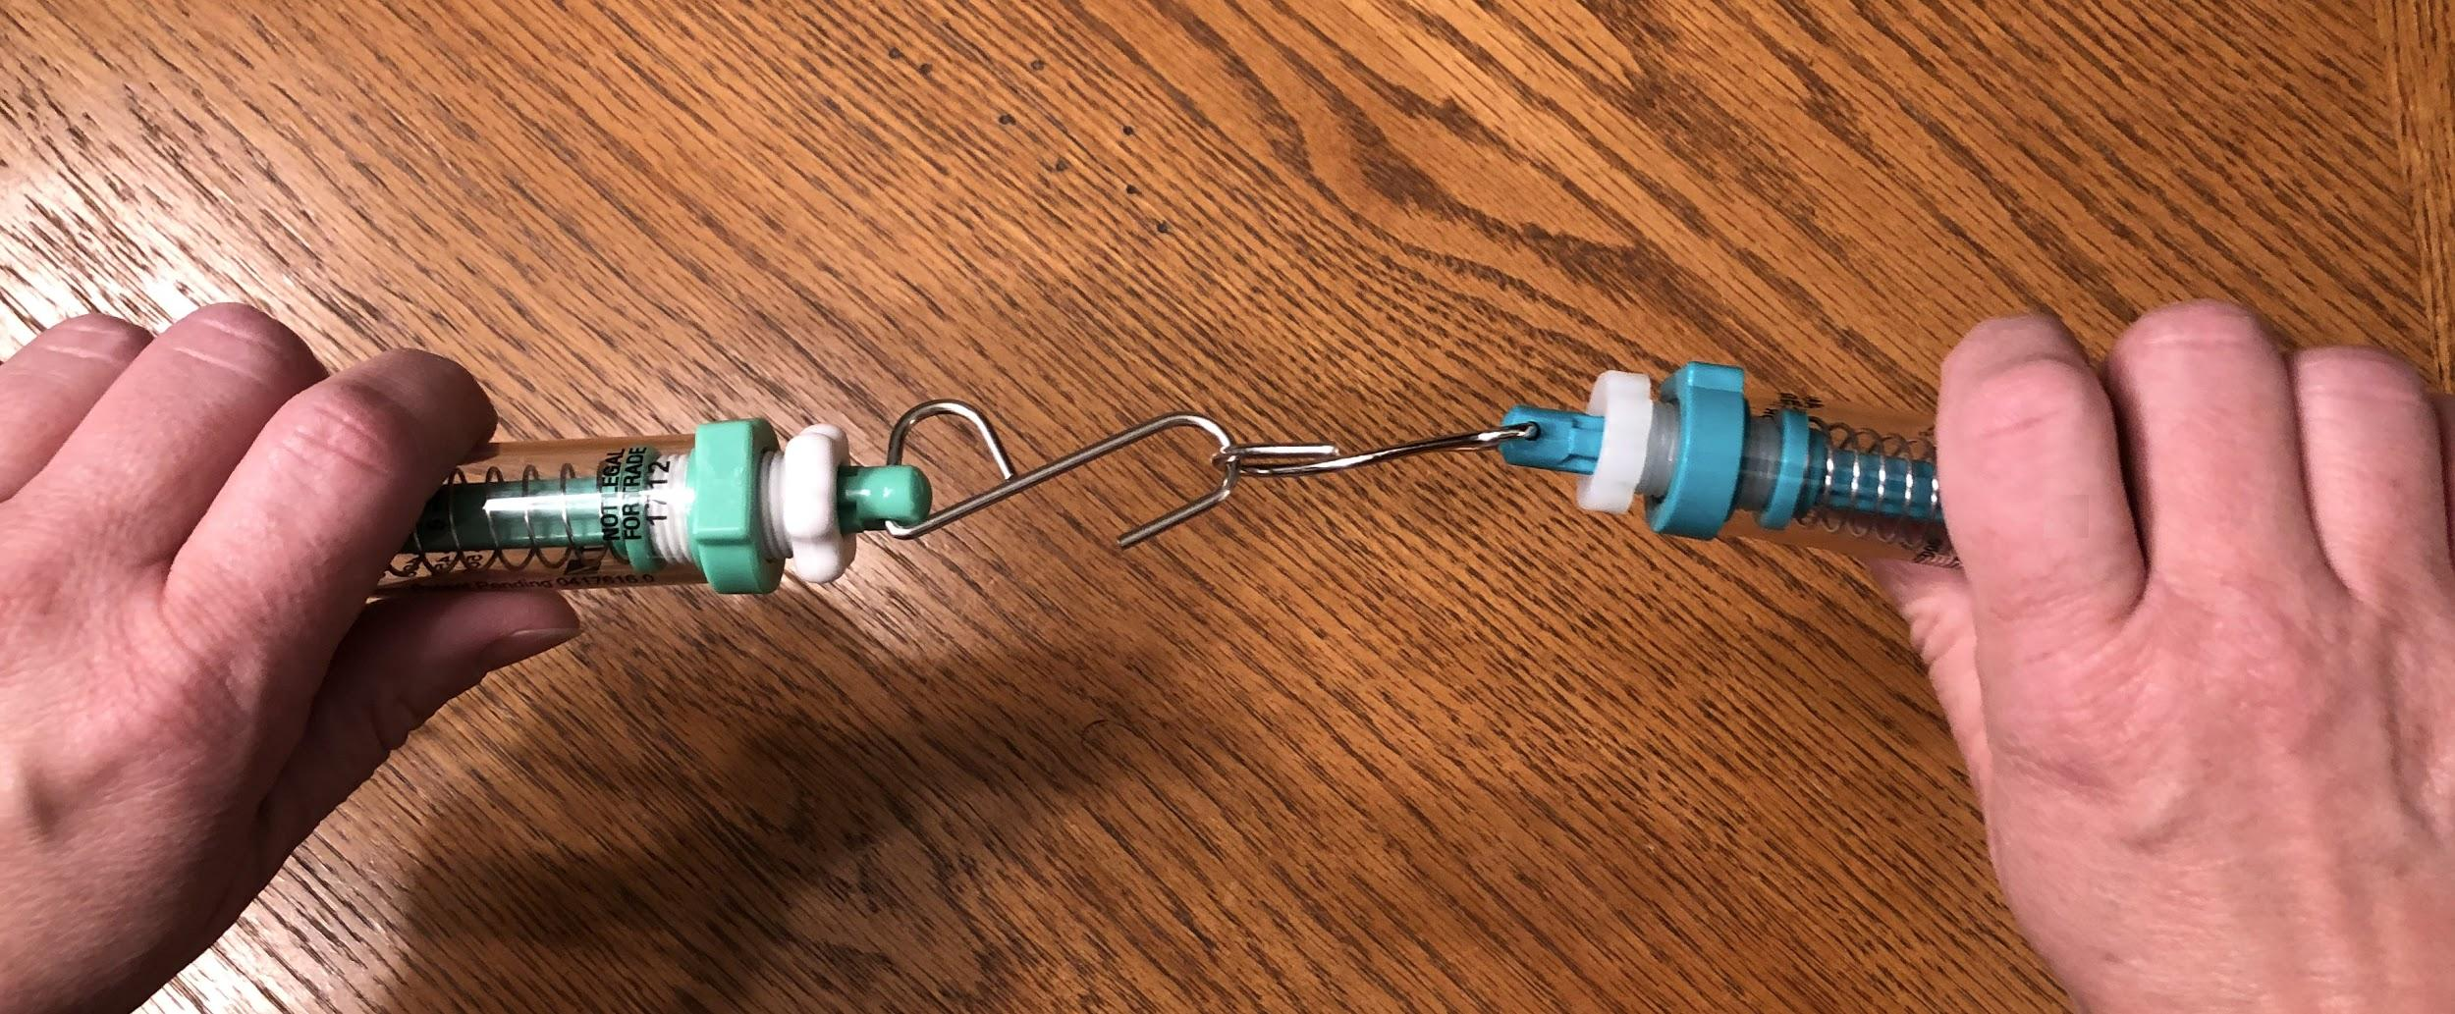
Making Predictions
Slide D
Notes:
10 min. Ask for ideas for how we could measure and compare the amount of force on objects that make contact. Say, OK, so we can see evidence of forces on both objects that make contact with each other when we use our fingers as force detectors. But our fingers have some limitations in terms of comparing the amount of force on them. Though we can try to say whether we feel or see evidence of more or less force on them, they don’t provide an exact measurement of the strength of the forces applied to them. What tools have we used in previous investigations to help us get a more-exact measurement of the strength of the force being applied to an object? Students will say the spring scales.
Say, Let’s use those again to investigate how the strengths of contact forces compare. First we’ll make some predictions for what the spring scales would show if we pushed them against each other or hooked them together and pulled them apart . Distribute Comparing Forces on Two Push-Pull Spring Scales. Show slide D. Give students about 2 minutes to complete their predictions.

Slide 5
Exploring Force Interactions with Spring Scales
Slide E
After everyone in your group has recorded their predictions, get 2 spring scales for your group and zero both of them. Also pick up 1 S hook.
Two group members should each hold a spring scale and test the push interactions described on the handout. Everyone should record results.
Assign two different group members to each hold a spring scale, connected with an S hook, and test the pull interactions described on your handout. Everyone should record results.
Discuss the following:
In every case, how does the strength of the forces on each object compare?
Be prepared to share your findings with the class.
Notes:
Have groups carry out the investigation steps summarized on slide E. It should take no more than five minutes for groups to get their spring scales and S hook, carry out their investigation, and record their results.

Slide 6
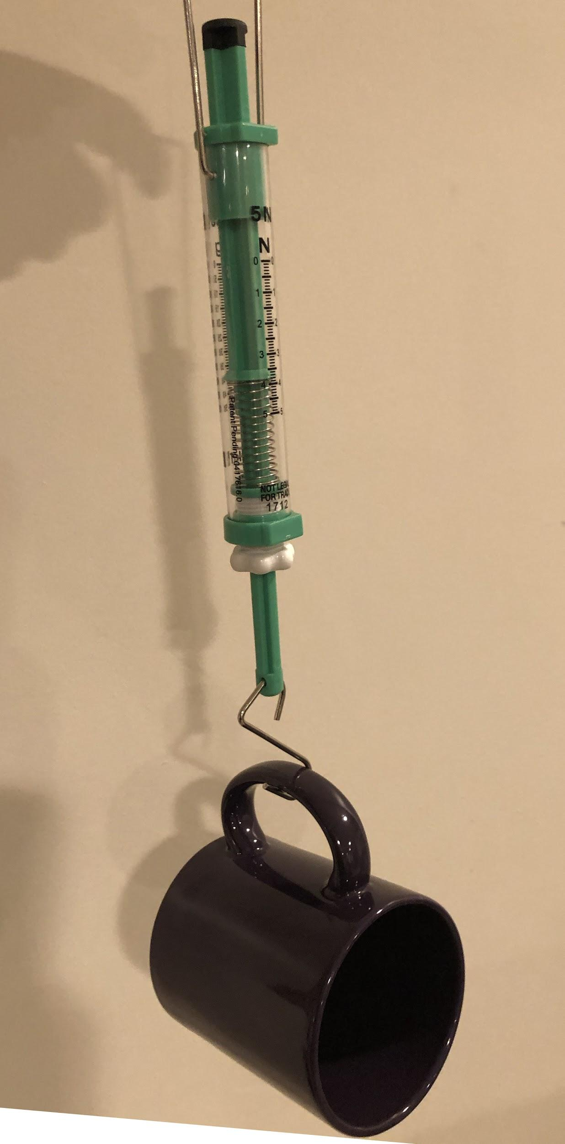
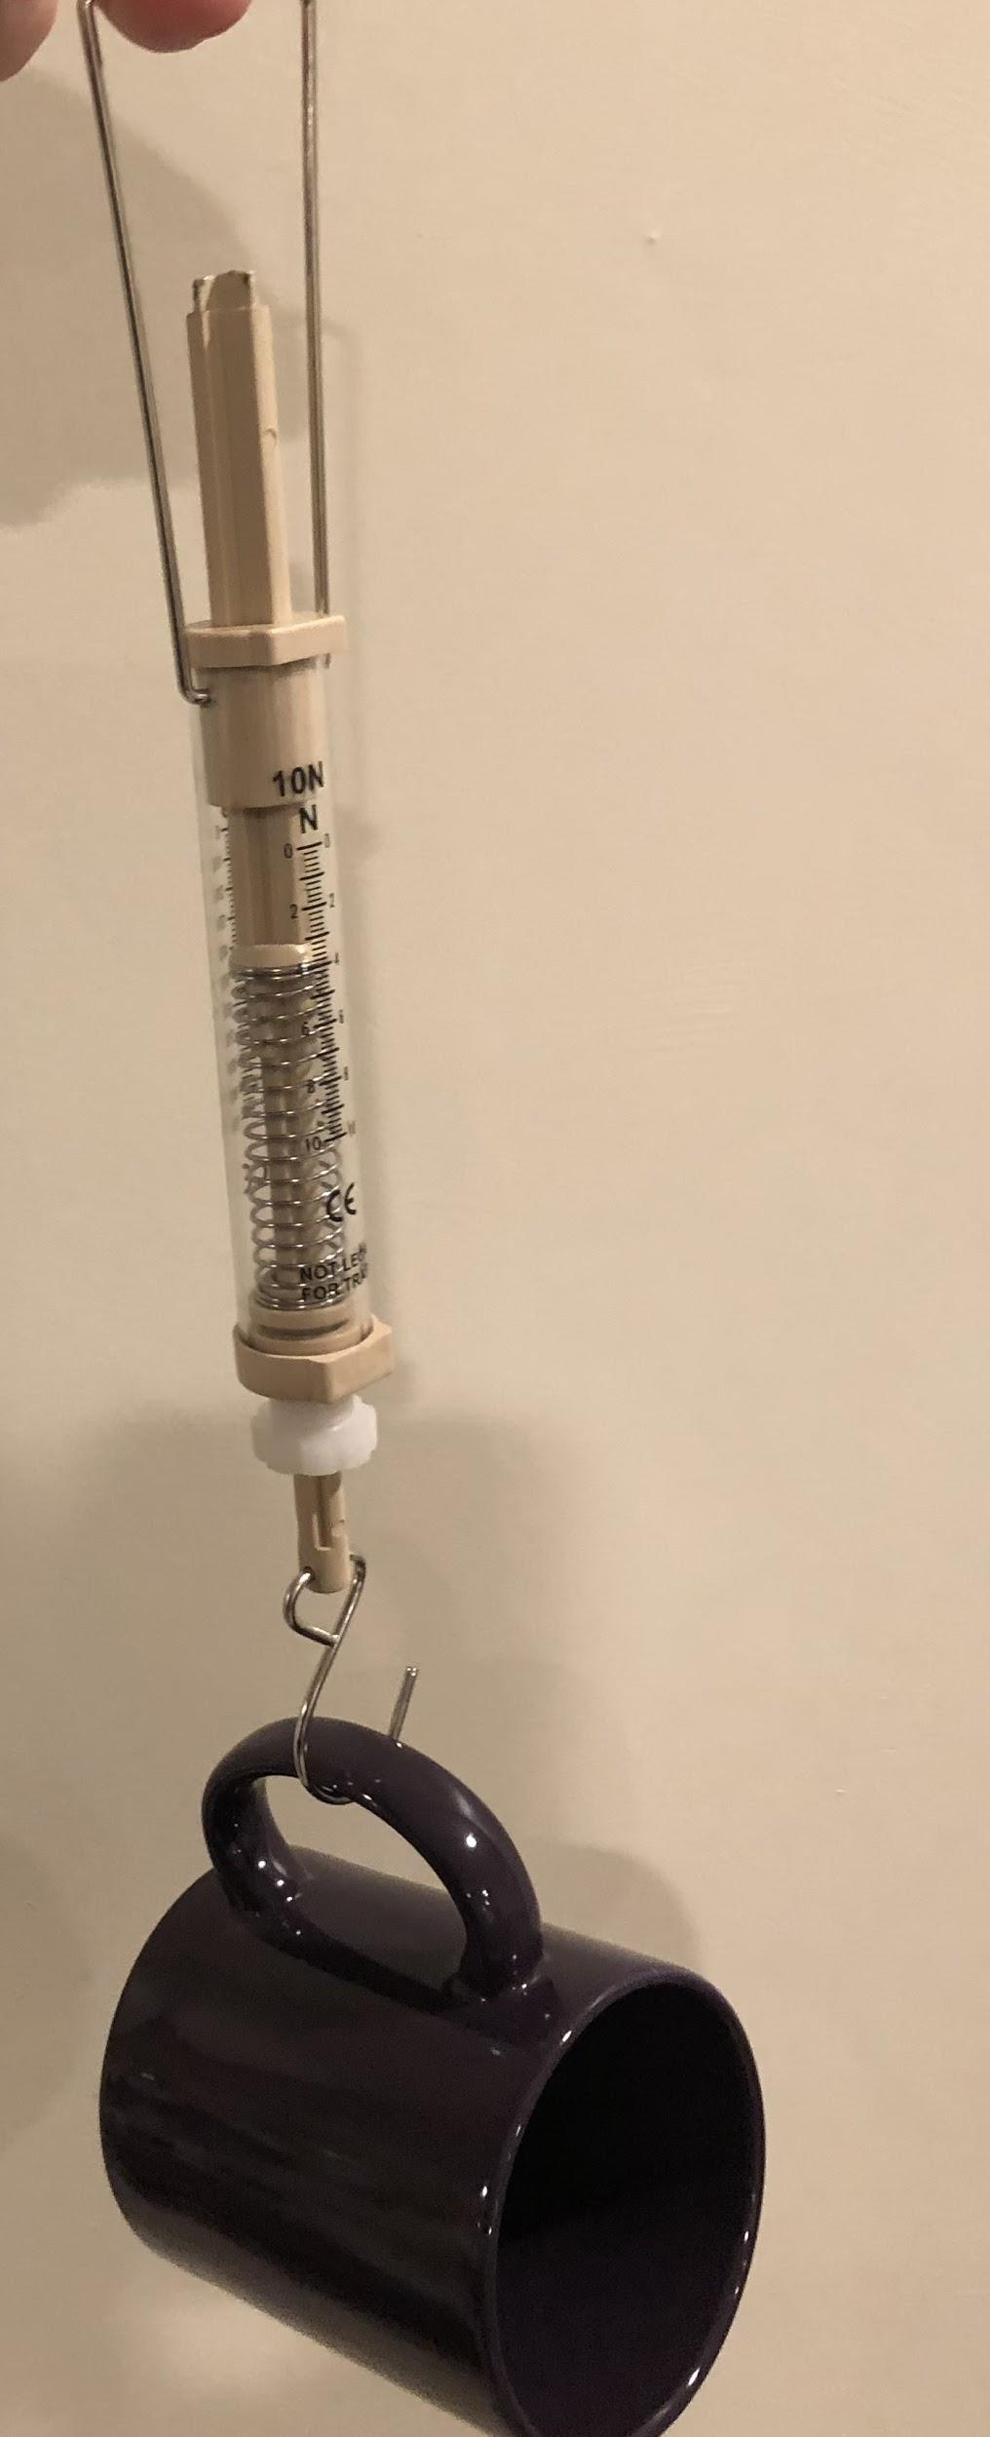

Making Predictions
Slide F
The spring in the scale on the right is stiffer than the spring in the scale on the left.
The spring in the scale on the right stretches half as far as the one on the left when the same weight is hung on both.
Discuss Your Predictions
How will the forces on these different spring scales compare when you push them against each other?
Notes:
12 min. Ask students to push their spring scales away from them to the center of the table while the class has a brief discussion.
Ask students What did your results show you about how the strength of the forces on each object compare when two objects make contact with each other? Are those forces the same strength or different? What evidence supports your claim?
Help students summarize their findings across the two investigations. Example prompts and responses can be found in the teacher guide.
Say, Let’s summarize what we’ve figured out. Add this idea to a poster titled “Contact Force Interactions”:
When two objects make contact, each object applies a force on the other object on the surface they touch.
Introduce another case to consider. Say, OK, so we know that all objects are elastic up to a point. When we made contact between two of the same type of object, two fingers or two spring scales, we found that they always pushed back or pulled back with equal strength on each other. But we also know that not all objects have the same level of springiness. Some deform a lot and some deform relatively little for the same amount of force applied to them. I have some spring scales that are like that too. Let’s see how we can use those to explore how the forces compare when objects with different springiness push on each other.
Make predictions. Say, Let’s get ready to use these different spring scales to test what would happen to the forces between any two objects when they make contact with each other, even when those objects have a different elasticity.
Describe how a 5-N vs. 10-N spring scale deform when the same force is applied to them. Show slide F. Have students discuss predictions with their group, related to the question on the slide:
How will the forces on each spring scale compare when you push them against each other?
As they are doing this, distribute one 10-N spring scale to each group.
Test predictions. Once all spring scales are distributed, instruct students to take a couple of minutes to test their predictions they discussed from the previous question. by pushing one 5-N spring scale against the 10-N spring scale.
After a couple of minutes, ask students to push their spring scales away from them to the center of the table while the class has a brief discussion. Refer to the Contact Force Interactions poster and ask if the statement on it was supported or refuted by the evidence collected from this investigation and what new ideas we can add to it.
Add this idea to the Contact Force Interactions poster by revising the statement that is already there. Then add the second statement to the poster:
When any two objects make contact, each object applies a force on the other object on the surface they touch. The strengths of those forces are the same but in the opposite directions.
Add this idea to the Contact Force Interactions poster by revising the statement that is already there. Then add the second statement to the poster:
When any two objects make contact, each object applies a force on the other object on the surface they touch. The strengths of those forces are the same but in the opposite directions.

Slide 7
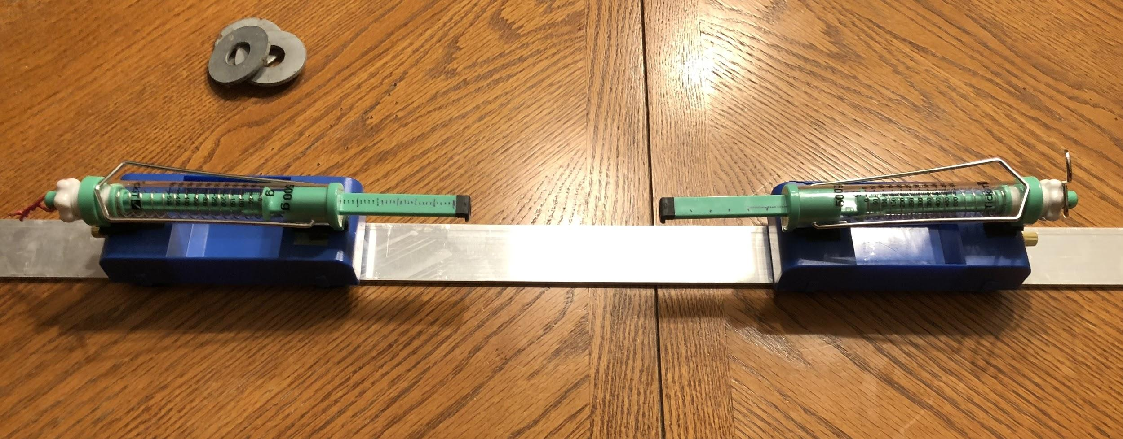
Planning Our Next Investigation
Slide G
Discuss as a Class
What are some different collision conditions that we could possibly test with these carts?
Notes:
8 min. Motivate an investigation about whether these generalizations hold true with collisions. Say, We’ve seen support for these ideas when we are holding the objects and applying a gentle push or pull to them. But do these ideas still hold true when we have collisions? Would the same equal forces on both objects happen when something is moving without us holding onto it and it collides into something else? Would changing anything about the moving object affect the forces between the two things when they make contact? Let’s brainstorm some different collision conditions that we could possibly test with these carts.
Show slide G. Give students a minute to orient to the setup shown on the slide and then think on their own about the question on the slide before discussing it as a class.
Write student responses on a piece of chart paper and title it “How do forces on two colliding objects compare when we change … ?”. Guide students to think about 2 different cases: changing how fast the carts move and changing the mass of the carts.
Say, Let’s start planning to collect data to investigate these two variables. Ask students about what challenges they anticipate in data collection and investigation design.
Say, These are all important challenges to consider in your investigation design, along with how much data you will need to collect to be certain of your findings, since we know when there are potential sources of error, more data make us more certain of what we can conclude. Since we have two different variables to investigate as a class, we need some groups to investigate how changing speed of a moving object before it collides with another object affects the forces on both objects during the collision, and we need other groups to investigate how changing the mass of a moving object before it collides with another object affects the forces on both objects during the collision.
Write these two investigation questions at the bottom of the chart paper titled “How do forces on two colliding objects compare when we change … ?” and label each with a letter:
How does changing the speed of a moving object before it collides with another object affect the forces on those objects during the collision?
How does changing the mass of a moving object before it collides with another object affect the forces on those objects during the collision?

Slide 8
How does changing the speed of a moving object before it collides with another object affect the forces on those objects during the collision?
How does changing the mass of a moving object before it collides with another object affect the forces on those objects during the collision?

Slide 9

Planning Our Next Investigation
Slide H
On Your Own
Record on your handout the question your group will be investigating.
Tape the handout into your notebook.
Notes:
Distribute Lesson 5: Independent, Dependent, and Controlled Variables. Show slide H. Assign half the class (three groups of 3-4 students) one of these questions to investigate and the other half of the class (three groups of 3-4 students). the other question. Instruct students to record the question they have been assigned on their handout and tape the handout into their notebooks.
2 min. Revisit using fingers as force detectors in prior investigation. Say, You have used your fingers as force detectors today. Other places on us can detect contact forces against the skin too. Take a moment to touch the tip of your finger to the following: your forehead, your cheek, and your elbow. Pay attention to which of these seems most sensitive to being able to detect something touching it. Give students a moment to do this as you distribute How Does Touch Work? to each student.
Summarize the focus of the reading. Explain that the home learning will give us more information about how our sense of touch works and how this connects to what students figured out about neurons in the Healing Unit.

Slide 10
Navigation
Slide I
Discuss as a Class
What are different groups investigating?
How do you predict changing this variable will affect the forces on both objects in your collisions?
How is investigating this variable connected to the ideas we have developed so far about why things sometimes get damaged when they hit each other?
Notes:
Follow up on the home learning assignment. If you assigned Reading: How does touch work? as home learning, ask students to turn and talk with a partner and summarize the most interesting idea they uncovered in the reading. Have students turn in the reading for you to review their responses.
Identify what we are planning to investigate today and why. Show slide I. Give students a minute to look at Lesson 5: Independent, Dependent, and Controlled Variables. in their notebooks to find which investigation question their group is going to plan for and think about what they predict. Then report these in a whole-class discussion as well as what led us to investigate how the forces compare in collisions. Suggested prompts and responses are located in the teacher guide.

Slide 11
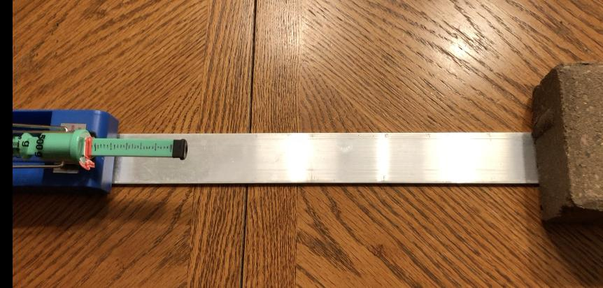
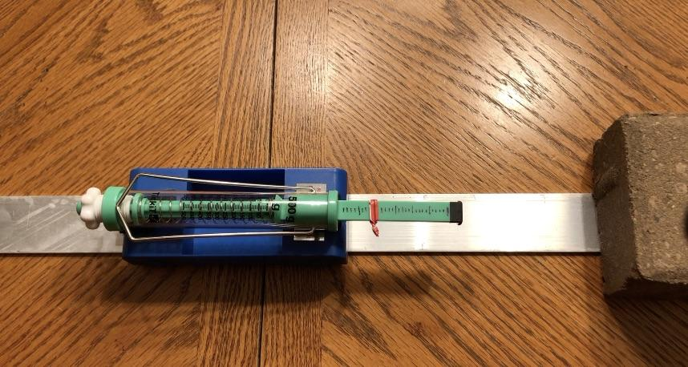
Introducing a Way to Measure Peak Force
Slide J
As a Class
Watch the demonstration video.
Discuss the following questions:
What happened to the twist tie collar in the collision?
How can this twist tie help us measure the maximum amount of force (peak force in a collision)?
Notes:
8 min. Introduce a peak force measurement device. Say, Before you design the rest of your investigation, I have one other device you can use to help you record a measurement of the maximum amount of force on the push-pull spring scales during the collision. It’s a simple twist tie collar that is wrapped on the plunger of the spring scale. Let me show you a video of how it works for a spring scale on a cart that collides with a brick. Show slide J.
Show https://youtu.be/HRYcfOPCoRo. Then ask students what they noticed happened to the twist tie collar and how this twist tie can help us measure the maximum amount of force applied during collision.
Say, This position of the twist tie collar can provide you a record of the maximum force or the peak force applied to the spring scale during a collision since each of the marks on the plunger beam corresponds to two of the marks on the newton side of the scale for the amount of force. Make sure to slide the collar back the first mark next to the scale (which is zero), after you record the result from a collision. Remember to develop a plan with your group that includes a method for how to control for different variables and a data table to record the peak force on the push-pull spring scale for each condition you test.

Slide 12


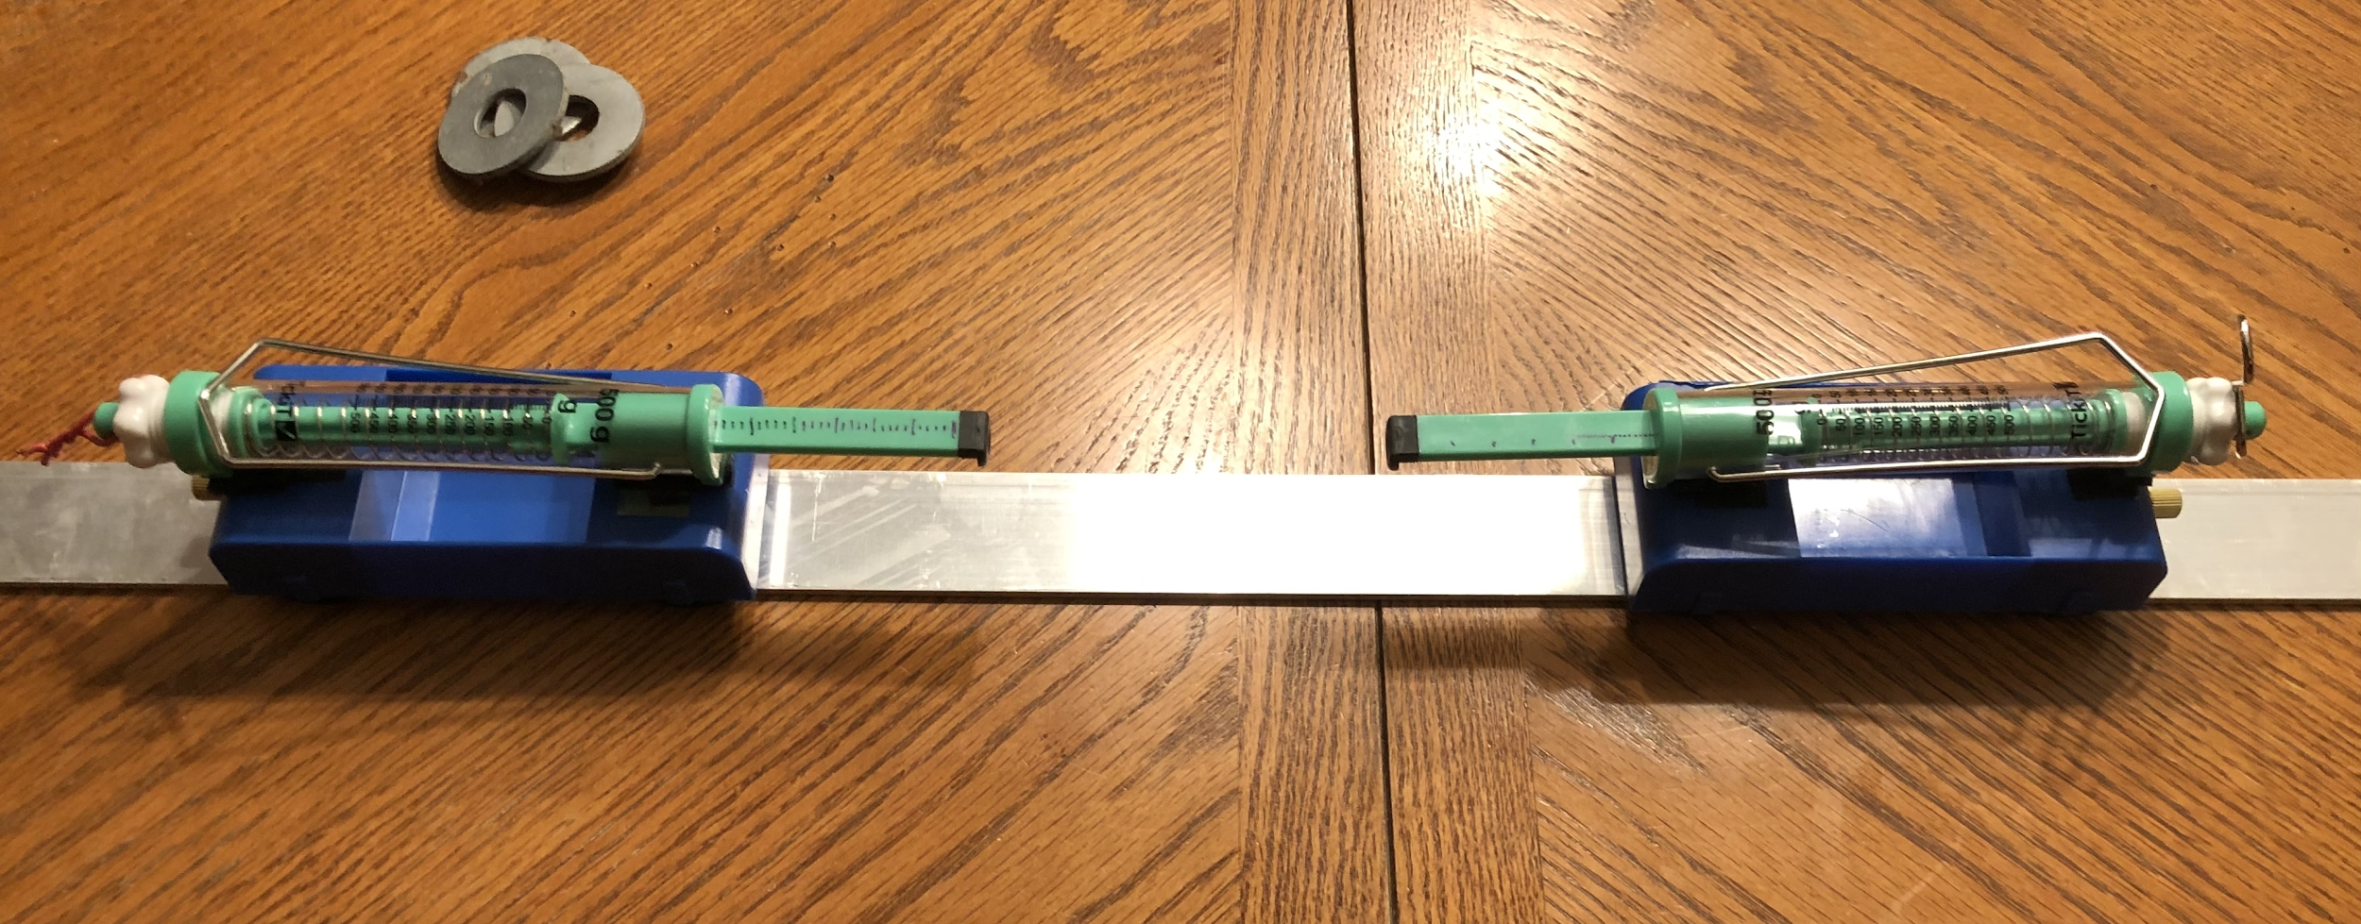
Investigating Peak Forces
Slide K
As a Group
Review materials you have available (shown here).
Discuss with your group and record on your handout the variables for your investigation.
On the next page of your notebook, set up a data table to record your results as well as a space to make note of any challenges or any sources of error you notice in your investigation.
Everyone in the group should have the setup complete, and goggles ready to put on, before going to the lab area to carry out your investigation.
Notes:
Review materials available and plan investigations. Show slide K. Say, The materials you have available are shown on this slide. Discuss with your group the variables you need to change and measure for your investigation and record them on Lesson 5: Independent, Dependent, and Controlled Variables
. Everyone in the group should prepare a data table to record your results on the next page of your notebook as well as a space to make note of any challenges or any sources of error you notice in your investigation. Everyone in the group should have impact goggles ready to put on before going over to the lab area to carry out your investigation.
10 min. Monitor lab work. Keep slide K projected.

Slide 13


Slide L
Update Progress Tracker
On Your Own
Progress Tracker
Question
What I
figured out
Add to your Progress Tracker. Record the question we are trying to figure out: How does changing the mass or speed of a moving object before it collides with another object affect the forces on those objects during the collision?
Record what you figured out.
Be prepared to share these with the whole class.
Notes:
4 min. Update individual Progress Trackers. Show slide L. Ask students to record in their Progress Tracker this question and what they observed before we reconvene in a Scientists Circle to identify patterns in data and summarize what we figured out:
How does changing the mass or speed of a moving object before it collides with another object affect the forces on those objects during the collision?
Give students time to record their discoveries.

Slide 14

Slide M
Develop a Classroom Consensus Model
As a Class
Meet in a Scientists Circle and develop a model to represent what you figured about this question:
How does changing the mass or speed of a moving object before it collides with another object affect the forces on those objects during the collision?
Notes:
15 min. Gather students in a Scientists Circle. Display slide M. Bring the Contact Force Interactions poster to the circle. Ask students to share what they wrote in their individual Progress Trackers.
You will incrementally develop a system diagram to represent and summarize the key ideas that are developed in this Consensus Discussion by taping pieces of paper with accompanying annotations on them to this poster on half or full sheets of paper to allow you to clear off the chart before the next class.
Purpose of this discussion: Help students come up with another generalization that adds to the rule that the contact forces will be the same on each object in a collision regardless of changes in speed or mass. Connect the results of the investigation to changes in the kinetic energy of the objects and changes in the peak forces in the collision.
Look for these ideas (in bold below) to add to the Contact Force Interactions poster. Add these to the poster under the statements already included (the sentences in italics below):
When any two objects make contact, each object applies a force on the other object on the surface they touch. The strength of those forces are the same but in opposite directions.
This is true even when we change the speed or mass of the moving objects in the system.
Increases in speed or mass of a moving object can result in an increase in the peak forces that are applied to both objects that make contact during the collision.
Say, Let’s summarize what we noticed happened to the peak forces on both objects, the push-pull spring scales, when they collided after putting one of the subsystems they were attached to, a cart, into motion.
Example responses for these prompts are located in the teacher guide.
In the entire system we used for our investigation we collided two subsystems together. What were those two subsystems again?
How does changing the speed of the cart subsystem before it collides with the other cart subsystem affect the peak forces on both objects that made contact (the push-pull spring scales) during the collision?
How does changing the mass of the cart subsystem before it collides with the other cart subsystem affect the peak forces on both objects that made contact during the collision?
How does the amount of deformation that happens on each spring scale change as these peak forces increase?
Say, Let’s try to represent the relationship between these force pairs in a collision by showing what we know about the state of the system before the collision and during the collision when both objects in it experience peak forces.
Suggest that since there are no contact forces between the two cart subsystems until during the collision, and this is evident by there being no compression of the spring scales, it would make more sense to take a force perspective during the collision.
Add the annotations shown in orange in the teacher guide regarding deformation to each row of the poster.
Ask, Are there any contact forces between subsystem A or subsystem B before they collide? No.
Ask students how many of the objects/subsystems experience a force applied to them during the collision. Students should say two.
Introduce a convention for modeling forces on a single subsystem or object (free body diagrams). Say, We could try to represent the forces on both objects in the system in the same diagram. But, since every place where there is contact, there will be two subsystems making contact and therefore there will be two forces between them, scientists and engineers usually switch to representing one single subsystem at a time in its own drawing. When they do that, they refer to each subsystem they draw as a free body diagram. It’s called a free body diagram because in the diagram you show only a single object or body in the system, but you don’t show any of the objects that are actually making contact with it. You free it up from the surroundings. But you still add in the forces that you know are acting on the object. Let’s draw two free body diagrams now, one for each of these cart subsystems, to show how the forces on each compare.
Add a column labeled “Free body diagrams” to the right side of the chart paper. Ask students what is pushing on subsystem B during the collision. Students should say the end of the spring scale in subsystem A. Ask students to point in the direction that shows which way the force is pushing on subsystem B. Students should point to the right.
Say, We can represent the direction of that force on subsystem B with a straight arrow going to the right, and we can show the tip of the arrow on the end of the spring scale plunger to indicate that this is the surface which the contact force is pushing. Draw subsystem B on a separate piece of paper and tape it to the chart.. Add an orange force arrow pointing to the right, touching the end of the plunger. Label this as “Peak force on subsystem B”. See the teacher guide for an example of what this looks like.
Ask students what is pushing on subsystem A during the collision. Students should say the spring scale in subsystem B. Ask students to point in the direction that shows which way the force is pushing on subsystem A. Students should point to the left.
Ask how we can show that the strength of the force is the same on subsystem A as on B, but in the opposite direction. Students will say that we can use the same-sized arrow as before but facing the opposite way. Add the text “... is equal in strength to ...” and then draw subsystem A below it. Add an orange force arrow pointing to the left, touching the end of the plunger. Make sure it's the same size as subsystem B’s force arrow. Label this as “Peak force on subsystem A“. See the teacher guide for an example of what this looks like.
Ask students how we can represent what we know happens to the peak forces on these two subsystems when we have more mass or more speed. Students will say that you can show this by including arrows on both.
Ask whether those arrows should be different sizes from each other or the same size and why. Students will say that they should be the same size to show that the forces are still equal.
Add these representations and related labels to the model as shown in the teacher guide
Qualify the relationship you established between the peak forces in a collision. Say, This relationship holds true for any collision where one object is motionless before the collision and the other object moves into it. It also holds for when two objects move toward each other head-on in a collision. Increasing the mass or the speed of one of the moving objects before the collision will increase the peak contact forces between those two objects during the collision, and yet the strength of those forces will be the same on each object, but in opposite directions.
Problematize where the ability to produce stronger contact forces is coming from. Say, We saw that these forces were produced during the collision, but not before it. Why is that? What wouldn’t these forces occur until the objects actually make contact? Accept all answers.
Say, So it seems like something is occurring before the collision that makes a difference, but if we describe things from a force perspective, we really can only look at what is happening during the collision. What perspective can we use to analyze what is happening with these subsystems BEFORE collision that affects the outcomes of a collision?
Guide students to determine that taking a force perspective doesn’t seem like it would be useful, since there is no contact yet, but have described differences between the movement of items using an energy perspective.
Transition to an energy perspective to describe the subsystems before the collision. Point out that subsystem A is moving in this system before the collision and subsystem B is not. Refer students to the energy perspective we took when we were keeping track of differences in motion in the model we made in Lesson 1. Ask students to identify how we referred to the difference in an object that was moving vs. not moving, using the energy perspective.
Example responses for these prompts are located in the teacher guide.
Before you carried out your investigations, neither cart subsystem was moving. At that point does either subsystem have kinetic energy?
If you hold one cart stationary and push and release the other cart to put it in motion, what parts of the system now have kinetic energy and which do not?
What happens to the amount of kinetic energy the cart subsystem has when you increase its speed?
What happens to the amount of kinetic energy the cart subsystem has when you put it into motion at the same speed as before but with more mass?
Say, We’ve already argued that there are no contact forces between subsystem A and subsystem B until they collide. But, we are arguing here that one of those subsystems, the one in motion, has kinetic energy and that the amount of kinetic energy it has changes based on its mass or its speed.
Add “(energy perspective)” in green under the column head “Before the collision”. Ask students which part of the system shown in the top left cell of the table should be labeled as having kinetic energy. Students should say subsystem A has kinetic energy and subsystem B does not. Label this in the model in green as shown in the teacher guide.
Ask students how we would describe the relative amount of kinetic energy of subsystem A when it is going faster. Students should say it has more kinetic energy. Ask the same about when the mass is increased. Again students should say it has more kinetic energy. Label this in the model in green as shown in the teacher guide.
If students are uncertain about this, you can ask them to consider what has more kinetic energy, a single cart traveling at a certain speed or two carts connected together traveling at that same speed.
Ask the following question, Our model shows that the mass and speed of a moving object influence its kinetic energy. What does our model show the relationship is between the amount of kinetic energy in the system and the peak forces between the objects in the system when they collide?
The more kinetic energy in the system the higher the peak forces will be between the objects in the system when they collide.
Qualify the relationship you established between the kinetic energy in the system and peak forces in a collision. Say, This relationship holds true for any collision where one object is motionless before the collision and the other object moves into it. It also holds for when two objects move toward each other head-on in a collision.✱

Slide 15
Slide N
Exit Ticket
On Your Own
Think back to one of your collision cases you shared with the class where one or both of the objects in the collision got damaged.
Which object(s) had kinetic energy before the collision?
How did the strength of the peak forces on each of these two objects compare during the collision? Were they equal in strength or unequal in strength?
If one of your moving objects was moving slower before the collision, how would that have affected its kinetic energy?
How would that have affected the peak forces in the collision?
Notes:
3 min. Refer to the model you developed to motivate testing the generalizability of these ideas in the upcoming assessment. Say, Since peak forces could either be weak enough to not exceed the elastic limit of the objects in a collision or be strong enough to cause permanent damage, it seems like we now have a chain of cause-and-effect reasoning that we can use to explain why some objects get damaged and others don’t in a collision. Let’s try to use this model to explain some of our initial collision-related phenomena as well as some new phenomena. Next time, you will have a chance to do that as part of a more-formal assessment opportunity. You will be able to use your notebook and you can use the consensus model we developed on this chart paper too as reference. Before we do that more-formal assessment, let’s complete a short exit ticket to check in on how you are thinking these ideas we developed would apply to something from our anchoring phenomenon.

